Slide 1
25 – Clean Code – Design Patterns
Based on the CleanCoders videos by Uncle Bob Martin
Rupert Waldron

Slide 2
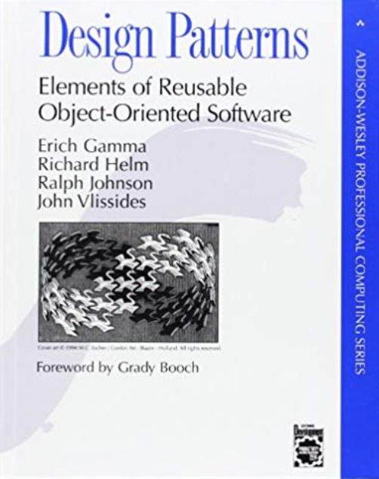
So What is a design pattern?
A design pattern is a named solution to a problem in a context
Naming the pattern helps developers discuss solutions to a design problem
Types of Patterns:
Creational Patterns – help create instances of objects
Structural Patterns – help set up the communication pathways between separate groups of objects
Behavioural Patterns – help you partition the behaviours of your system into discrete patterns.
GOF Book

Slide 3
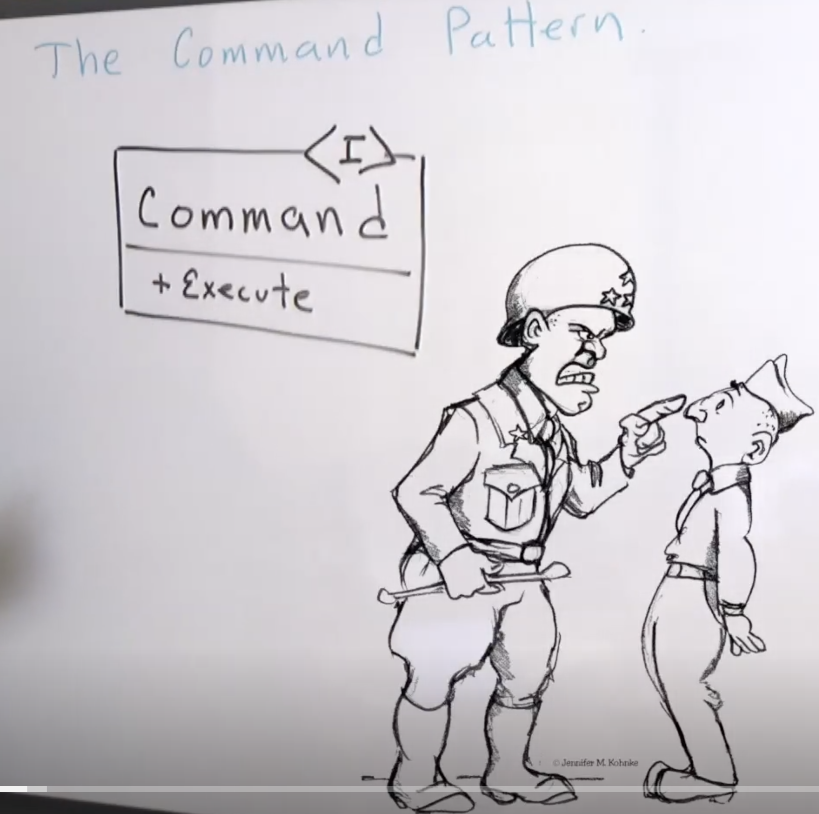
The Command Pattern
The command pattern is a way of coupling what is done from who does it.
It can decouple what gets done from who does it – special decoupling. And also you can store commands objects in an array and execute them at a specific time – temporal decoupling.
Code : turn lights on and off

Slide 4
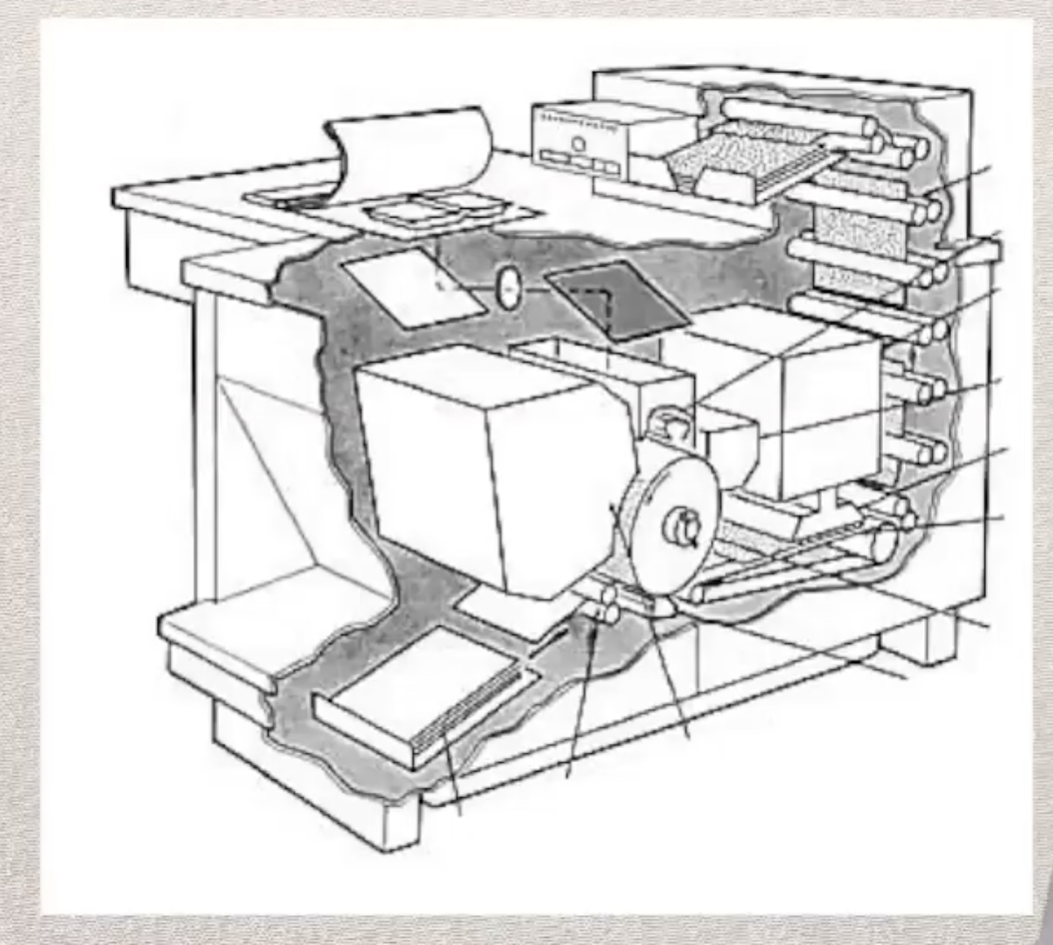
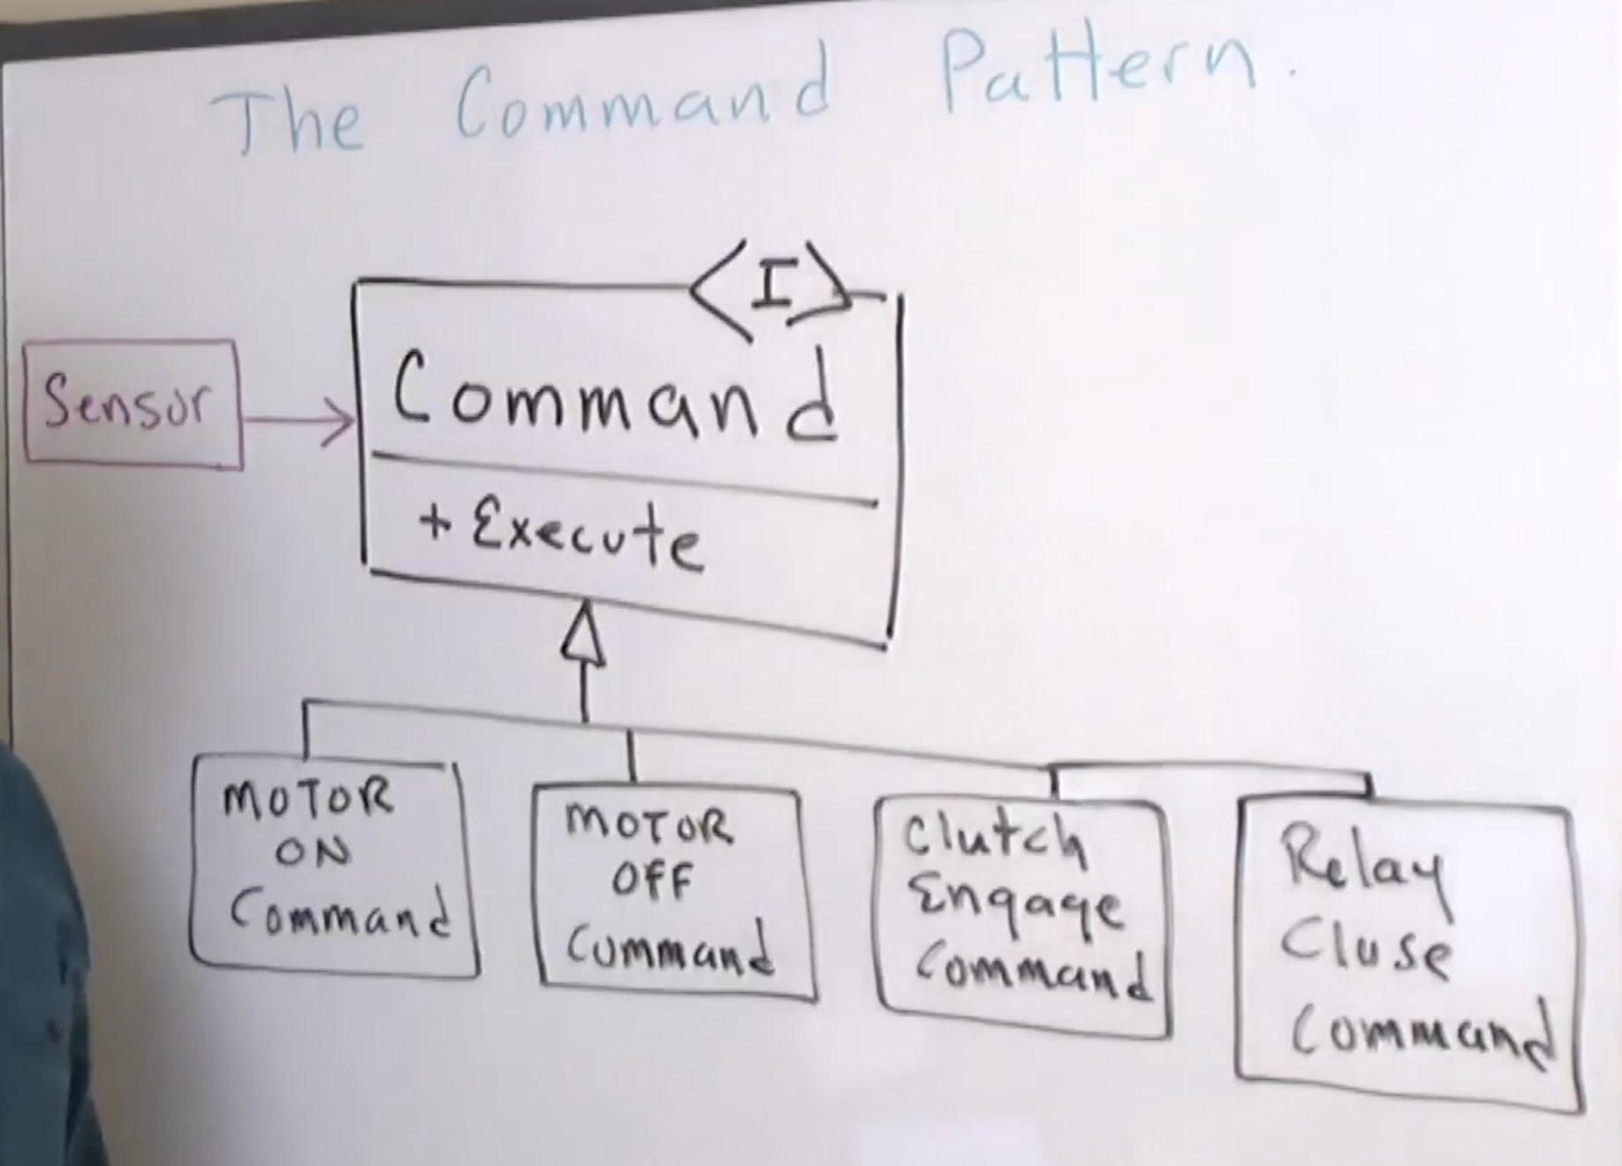
Xerox colour copier example – special decoupling
Lots of motors to control
Every time the sensor is tripped the exectute() method on the command object is called
Sensor contains a command object
The sensor knows nothing about the type of device it is controlling
The Command Pattern is a great way of de-coupling what is done from who does it
Code : process requests

Slide 5
You can even implement Undo!
If you store the commands in the order they are executed you can undo them in the correct order… is this something that could be useful?
class SavePayment implements ReqCommand { private RestRepository repo; private RestRequest request; public SavePayment(RestRepository repo, RestRequest request) { this.repo = repo; this.request = request; } @Override public void execute() { if (request.isSaveCard()) { repo.save(request); System.out.println("Card is saved"); } } @Override public void undo() { if (request.isSaveCard()) { repo.remove(request); System.out.println("Card is un-saved"); } } }
interface ReqCommand { void execute(); void undo(); }

Slide 6
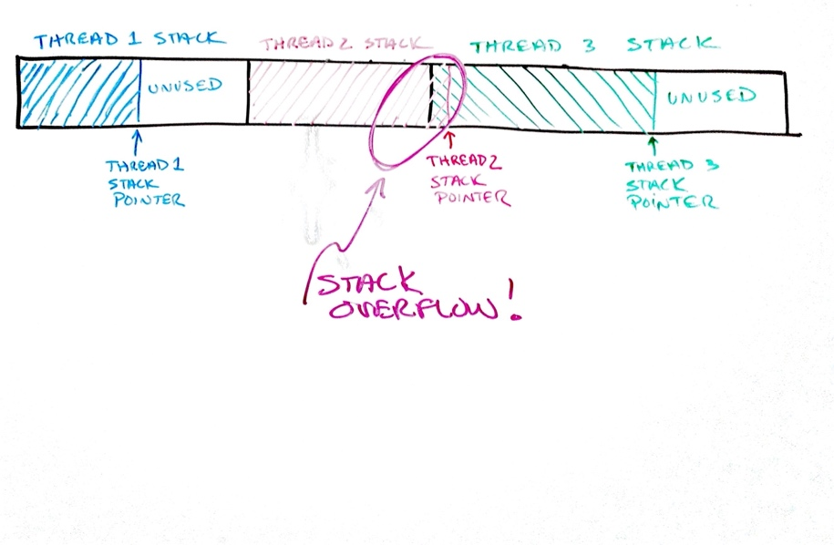
Actor model
Actor model lets multiple asynchronous threads share the same stack
The threads have there own allocated memory, unfortunately you are never quite sure how much memory to allocate… sometimes they run over into one another – here thread 3’s data has been over written.
Accidents involving autonomous cars have been put down to stack overflow

Slide 7
Actor model – the code
static class ButtonActorCmd implements ActorCmd { private final ActorCmd onTrigger; private final String trigger; ButtonActorCmd(String trigger, ActorCmd onTrigger) { this.onTrigger = onTrigger; this.trigger = trigger; } @Override public void execute() { actorCmds.add(triggerReceived() ? onTrigger : this); // if it isn't pressed it goes back on the stack } private boolean triggerReceived() { return pressedKeys.contains(trigger); } }
public static void main(String[] args) { ActorCmd lightOn1 = new LightOn(1); ActorCmd lightOn2 = new LightOn(2); ActorCmd lightOn3 = new LightOn(3); ActorCmd lightOn4 = new LightOn(4); ActorCmd button1 = new ButtonActorCmd("1", lightOn1); ActorCmd button2 = new ButtonActorCmd("2", lightOn2); ActorCmd button3 = new ButtonActorCmd("3", lightOn3); ActorCmd button4 = new ButtonActorCmd("4", lightOn4); actorCmds.add(button1); actorCmds.add(button2); actorCmds.add(button3); actorCmds.add(button4); Thread listener = new Listen(); listener.start(); while (!actorCmds.isEmpty()) { ActorCmd cmd = actorCmds.pop(); cmd.execute(); } listener.join(); }
The Button waits for a trigger, if the trigger has been received – from IO device – the the onTrigger(Callback) command will be executed.
If a trigger the command goes back into the list an and waits until it comes round again… just like how a thread would behave.
This works asynchronously but with just the one thread
Actor model is used in Network Switches – Hydra?

Slide 8
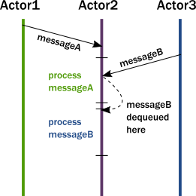
Actor model – sending messages
An important difference of passing messages instead of calling methods is that messages have no return value. By sending a message, an actor delegates work to another actor. It expected a return value, the sending actor would either need to block or to execute the other actor's work on the same thread. Instead, the receiving actor delivers the results in a reply message.
The second key change we need in our model is to reinstate encapsulation. Actors react to messages just like objects "react" to methods invoked on them. The difference is that instead of multiple threads "protruding" into our actor and wreaking havoc to internal state and invariants, actors execute independently from the senders of a message, and they react to incoming messages sequentially, one at a time. While each actor processes messages sent to it sequentially, different actors work concurrently with each other so an actor system can process as many messages simultaneously as many processor cores are available on the machine. Since there is always at most one message being processed per actor the invariants of an actor can be kept without synchronization. This happens automatically without using locks:

